Slide 1
Knowledge Representation in AI
Week 5
Edward Ombui, PhD

Slide 2
Lesson objective
By the end of this lesson, students should be able to understand the importance of knowledge representation in artificial intelligence, explore different techniques, and apply these techniques to model information in a meaningful way.

Slide 3
Lesson Learning Outcomes
Articulate the advantages and challenges associated with different knowledge representation structures, including facts, rules, frames, semantic networks, ontologies, and knowledge graphs.
Create meaningful knowledge representations for given scenarios by exploring semantic networks and frames.
Identify real-world AI applications that integrate knowledge representation e..g. natural language processing, expert systems, and other domains.

Slide 4
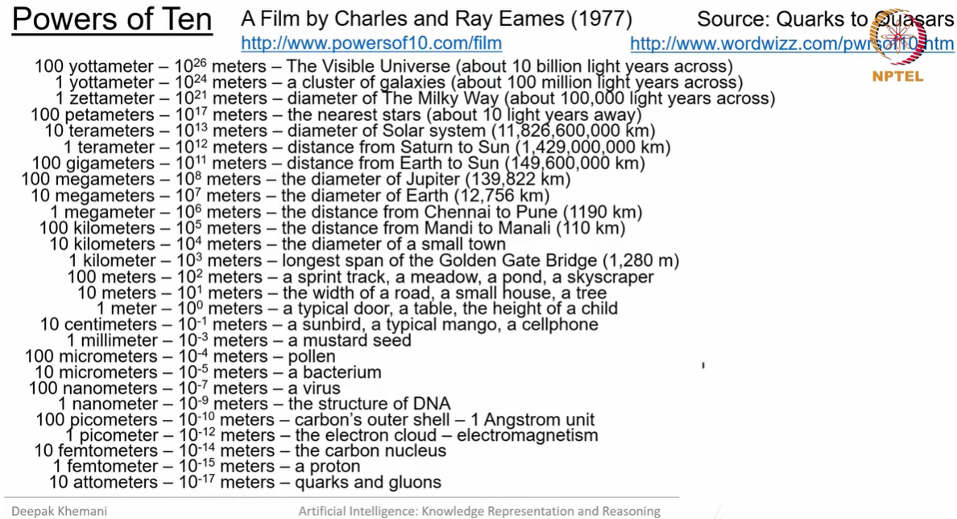
Powers of Ten™ (1977)
Notes:
Powers of Ten™ (1977)

Slide 5
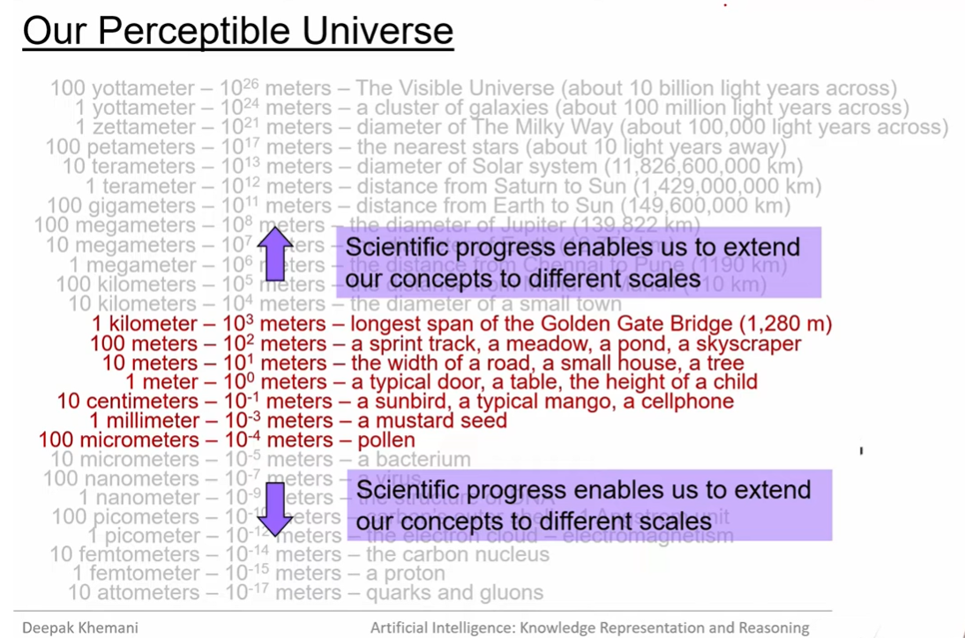

Slide 6
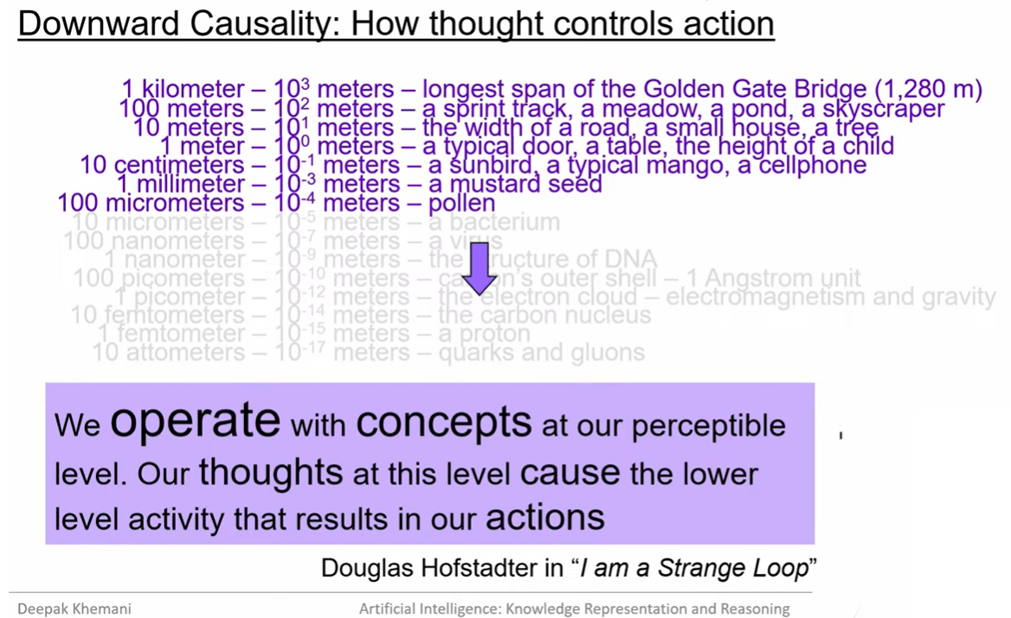

Slide 7
HOW DO I KNOW?
Ontology: What is REALITY? What is TRUTH?
Epistemology: The theory of knowledge (and justification)
Knowledge: Belief connected with the fact known in the right way
Knowledge is always of truths or realities; DEEP TRUTH
Belief is not knowledge but opinion
Justified belief: you have good reason to believe what you do, even if the belief is wrong
Does knowledge begin with experience? (experience gives us data about observable level)
Source of knowing: Scientifically (by observation and experimentation, and predictability of observables)

Slide 8
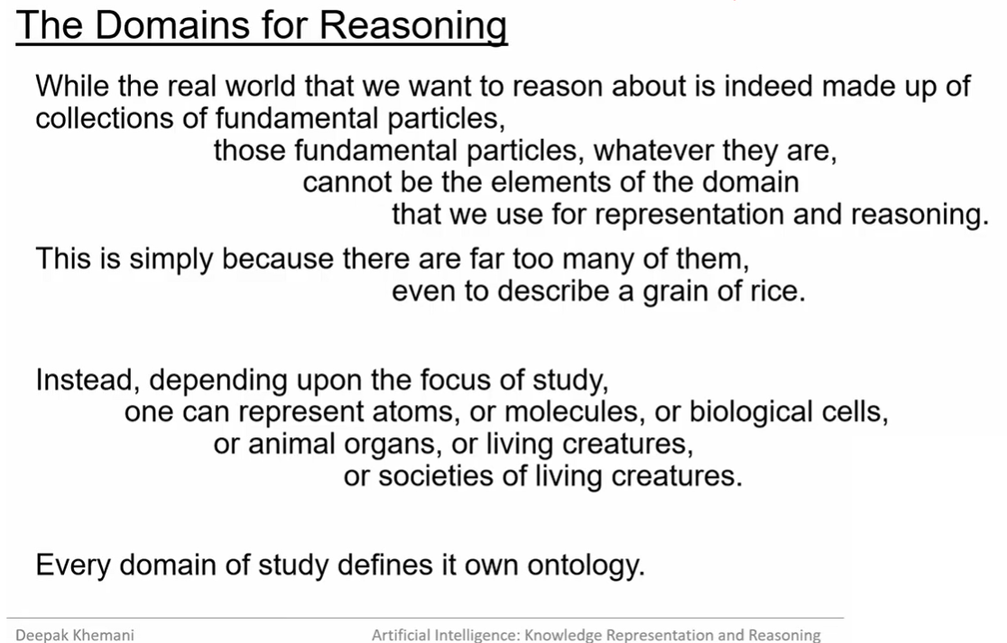

Slide 9
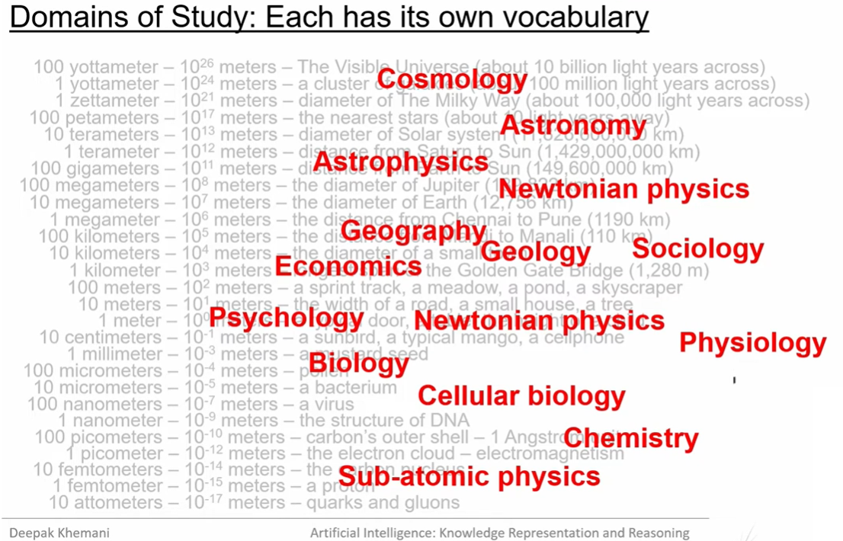

Slide 10
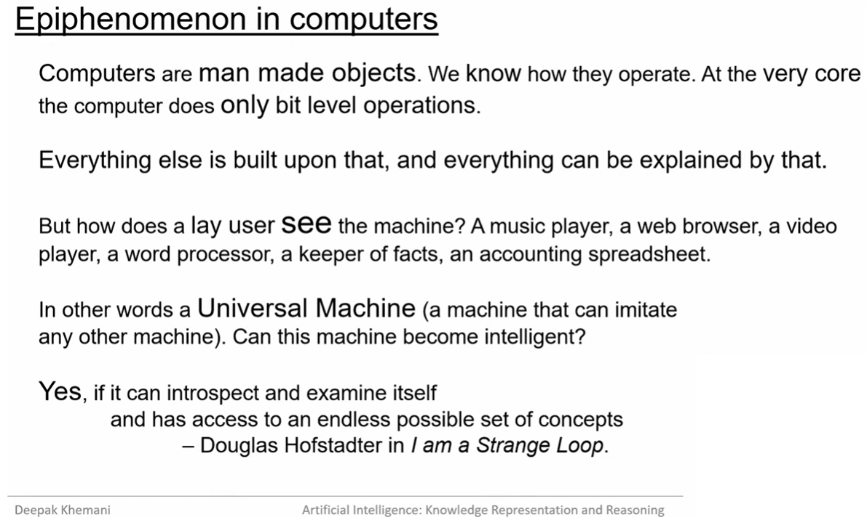

Slide 11
CONCEPTS for building AI
REPRESENTATION
The role of logic in knowledge representation and reasoning
Logic, the study of entailment relations: languages, truth conditions, and rules of inference
Predicate calculus: : the language of first order logic (FOL).
KNOWLEDGE
REASONING
Notes:
Knowledge: , knowledge is a relation between a knower, like John, and a proposition, that is, the idea expressed by a simple declarative sentence, like “Mary will come to the party
Representation: representation is a relationship between two domains, where the first is meant to “stand for” or take the place of the second. Usually, the first domain, the representor, is more concrete, immediate, or accessible in some way than the second.
Knowledge representation, then, is the field of study concerned with using formal symbols to represent a collection of propositions believed by some putative agent
Reasoning: , it is the formal manipulation of the symbols representing a collection of believed propositions to produce representations of new ones. It is here that we use the fact that symbols are more accessible than the propositions they represent: They must be concrete enough that we can manipulate them (move them around, take them apart, copy them, string them together) in such a way as to construct repressentations of new propositions.
FOL was invented by the philosopher Gottlob Frege at the turn of the twentieth century for the formalization of mathematical inference, but has been co-opted by the AI community for knowledge representation purposes.

Slide 12
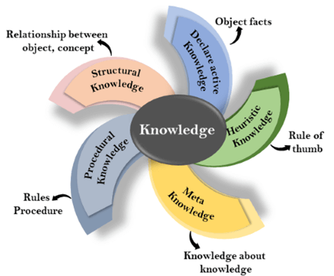
What is Knowledge?
Knowledge is awareness or familiarity gained by experiences of facts, data, and situations.
We make decision about what to do based on what we know about the world
Knowledge representation is the part of AI concerned with how an agent uses what it knows in deciding what to do.
KR: the study of thinking as a computational process, and the symbolic structures invented to represent knowledge
Types of Knowledge
Notes:
1. Declarative Knowledge:
Declarative knowledge is to know about something.
It includes concepts, facts, and objects.
It is also called descriptive knowledge and expressed in declarativesentences.
It is simpler than procedural language.
2. Procedural Knowledge
It is also known as imperative knowledge.
Procedural knowledge is a type of knowledge which is responsible for knowing how to do something.
It can be directly applied to any task.
It includes rules, strategies, procedures, agendas, etc.
Procedural knowledge depends on the task on which it can be applied.
3. Meta-knowledge:
Knowledge about the other types of knowledge is called Meta-knowledge.
4. Heuristic knowledge:
Heuristic knowledge is representing knowledge of some experts in a filed or subject.
Heuristic knowledge is rules of thumb based on previous experiences, awareness of approaches, and which are good to work but not guaranteed.
5. Structural knowledge:
Structural knowledge is basic knowledge to problem-solving.
It describes relationships between various concepts such as kind of, part of, and grouping of something.
It describes the relationship that exists between concepts or objects.

Slide 13
What is knowledge representation?
A process of organizing information in a structured way to facilitate reasoning, problem-solving, and decision-making within intelligent systems
It involves creating models that capture the essential characteristics of a domain, allowing an AI system to understand, interpret, and manipulate knowledge effectively.
The goal of knowledge representation is to enable machines to reason about the world in a manner similar to human cognition.
Notes:
a way which describes how we can represent knowledge in artificial intelligence.

Slide 14
What to Represent
Object: All the facts about objects in our world domain. E.g., Guitars contains strings, trumpets are brass instruments.
Events: Events are the actions which occur in our world.
Performance: It describe behavior which involves knowledge about how to do things.
Meta-knowledge: It is knowledge about what we know.
Facts: Facts are the truths about the real world and what we represent.
Knowledge-Base: The central component of the knowledge-based agents is the knowledge base. It is represented as KB. The Knowledgebase is a group of the Sentences (Here, sentences are used as a technical term and not identical with the English language).

Slide 15

Early Systems
Knowledge: Permissible Transformations
Reasoning: Search Algorithm
Issues
Real world data is challenging
Lack of generalization to large number of symbols
No learning

Slide 16
Recent Work
Speech recogmition
Image recognition
Deep Neural networks
Real valued vector (distributed representations)
Transformation from input to output is learned from data using backpropagation algorithm
Continuous data processing through real numbers

Slide 17
Related work in reasoning
Natural Language Inference
Visual Question Answering
Reading Comprehension

Slide 18
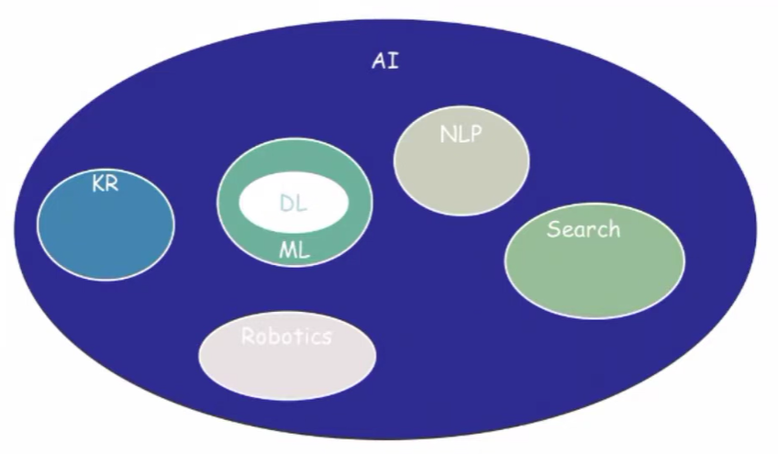

Slide 19
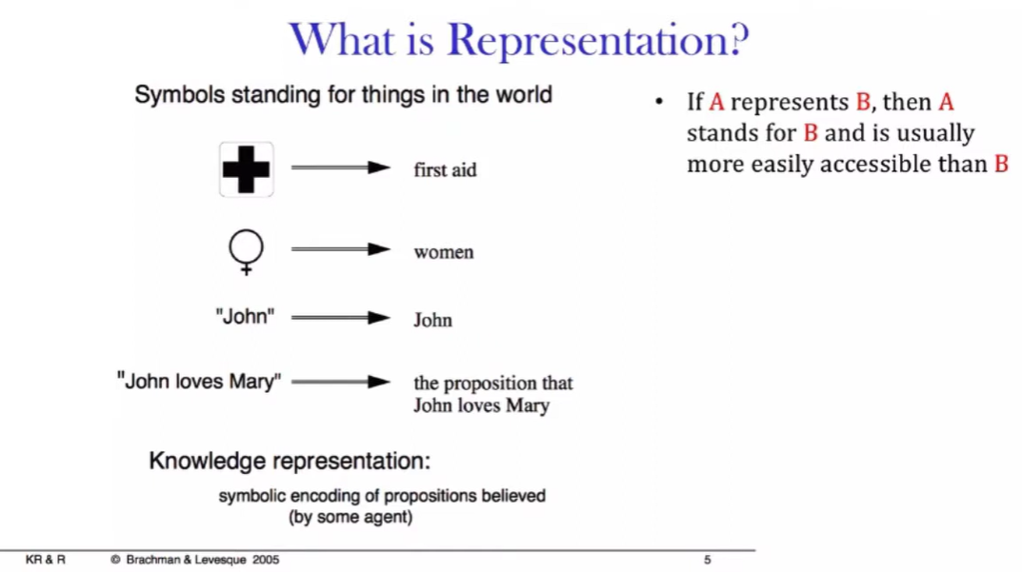

Slide 20
Knowledge Representation Schemes
Relational
Inheritable
Inferential
Declarative/Procedural

Slide 21
Simple Relational Knowledge
It’s the simplest way to represent facts, each set out systematically in columns
It stores set of attributes and its associated values
This approach of knowledge representation is popular in database systems where the relationship between different entities is represented
Player | Height | Weight | Wins
Morara | 5.7 | 61 | 7
Wanjohi | 6.1 | 72 | 4

Slide 22
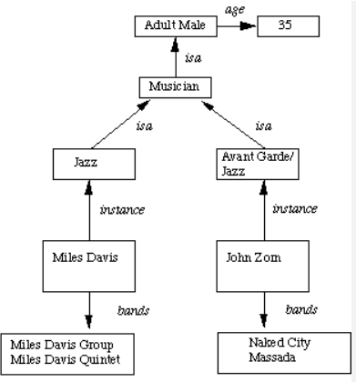
Inheritable knowledge
Here, all the data must be stored in a hierarchy of classes
Inheritance property is applied whereby elements inherit values from other members of a class
It shows the relation between an instance and class (instance relation)
Every frame can represent the collection of attributes and its values
Objects and values are represented in boxed nodes

Slide 23
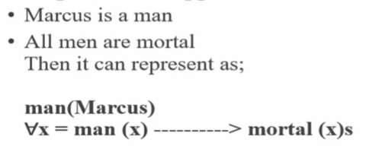
Inferential Knowledge
This represents knowledge in the form of formal logic
This approach can be used to derive more facts and guarantees correctness
Example: Given two statements
Sudanese are tall
Akuec is Sudanese This is represented as:
sudanese(Akuec)

Slide 24
Procedural Knowledge
This uses software programs and codes to describe HOW to do specific things
This approach uses the If-Then rule
Example coding languages include LISP and Prolog languages
We can easily represent heuristic or domain-specific knowledge using this approach
However, not necessary to represent all cases using this approach

Slide 25
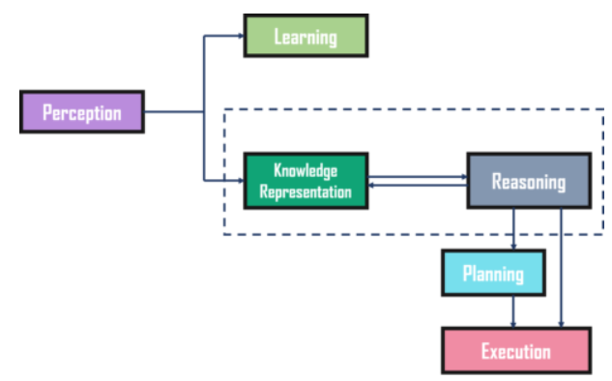
Cycle of Knowledge Representation in AI
AI Systems consist of various components to display their intelligent behavior. Some of these components include:
Perception
Learning
Knowledge Representation & Reasoning
Planning
Execution
Notes:
The Perception component retrieves data or information from the environment. with the help of this component, you can retrieve data from the environment, find out the source of noises and check if the AI was damaged by anything. Also, it defines how to respond when any sense has been detected.
Then, there is the Learning Component that learns from the captured data by the perception component. The goal is to build computers that can be taught instead of programming them. Learning focuses on the process of self-improvement. In order to learn new things, the system requires knowledge acquisition, inference, acquisition of heuristics, faster searches, etc.
The main component in the cycle is Knowledge Representation and Reasoning which shows the human-like intelligence in the machines. Knowledge representation is all about understanding intelligence. Instead of trying to understand or build brains from the bottom up, its goal is to understand and build intelligent behavior from the top-down and focus on what an agent needs to know in order to behave intelligently. Also, it defines how automated reasoning procedures can make this knowledge available as needed.
The Planning and Execution components depend on the analysis of knowledge representation and reasoning. Here, planning includes giving an initial state, finding their preconditions and effects, and a sequence of actions to achieve a state in which a particular goal holds. Now once the planning is completed, the final stage is the execution of the entire process.

Slide 26
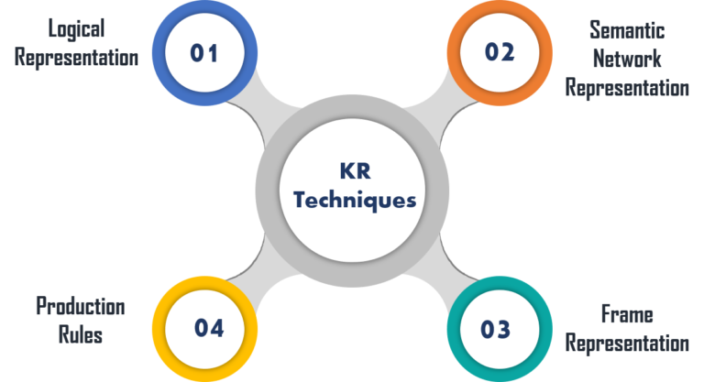
Notes:
Logical representation is a language with some definite rules which deal with propositions and has no ambiguity in representation. It represents a conclusion based on various conditions and lays down some important communication rules. Also, it consists of precisely defined syntax and semantics which supports the sound inference. Each sentence can be translated into logics using syntax and semantics.
Semantic networks work as an alternative of predicate logic for knowledge representation. In Semantic networks, you can represent your knowledge in the form of graphical networks. This network consists of nodes representing objects and arcs which describe the relationship between those objects.
A frame is a record like structure that consists of a collection of attributes and values to describe an entity in the world. These are the AI data structure that divides knowledge into substructures by representing stereotypes situations. Basically, it consists of a collection of slots and slot values of any type and size. Slots have names and values which are called facets.
In production rules, agent checks for the condition and if the condition exists then production rule fires and corresponding action is carried out. The condition part of the rule determines which rule may be applied to a problem.

Slide 27
Knowledge Representation Structures
Facts: Simple statements about the world.
Rules: Statements that specify relationships or conditions.
Frames: Structures that organize knowledge about objects or concepts.
Semantic Networks: Graph structures representing relationships between entities.
Ontologies: Hierarchical structures defining concepts and their relationships.
Knowledge Graphs: Graph databases that connect entities and their relationships.

Slide 28
References
https://www.youtube.com/watch?v=OmOwj3qMdOY
https://angeluriot.com/maze_solver/
Top 5 Most Common Graph Algorithms for Coding Interviews (youtube.com)
Breadth First Search (BFS): Visualized and Explained (youtube.com)
Depth First Search (DFS) Explained: Algorithm, Examples, and Code (youtube.com)

